Slide 1
“14. Media and think tanks in the economy”

Slide 2
Overview
Role of Think Tanks
Impact on Economy
Persuasion by Media
Notes:
What you’re going to talk about
Key points/Agenda
Think tanks
Media
Economy
(Hint: $$$)

Slide 3
Introduction
Notes:
Think tanks carry enormous sway in public discourse, with clout and networking that gives them tremendous access to our media outlets. Their aim is to help set policies for government and industry, as well as influence public opinion in order to reach their goals. But these institutions are not always as independent and unbias as we are lead to believe, often taking in lots of money from varied interests including industry, politics and even foreign governments. My presentation will be open this world to the audience, with the aim of enlightening and educating them, and hopefully propose some thought next time they are observed in media.

Slide 4
Think Tanks
Notes:
Think tanks are “”body of experts who do research and advocate for public policy”,
Politicians are expected to be well-versed on everyting from economics, to healthcare, to the environment. But many are not academics, doctors or scientists, so how do they form their policies? They turn to them
and are often described as “universities without students’ as researchers are supposed to function as non-partisan academics for answers to unresolved questions. Despite political leanings, their research is understood to be legitimate and evidence-based.
Their findings are widely trusted and often used to justify new laws, political talking points, and other shifts in public policy.

Slide 5
Types of Think Tanks
Notes:
Different types:
Ideological
Political
Issue-based
Environmental
Social

Slide 6
Funding of Think Tanks
Notes:
Gov’t
Private/Corp donors
Charitable Tax Status

Slide 7
Bias of Think Tanks
Notes:
Risk of leaning in the political direction of their sponsors, which can skew their findings
But in the chase for funds, think tanks are pushing agendas important to corporate donors, at times blurring the line between researchers and lobbyists. And they are doing so while reaping the benefits of their tax-exempt status, sometimes without disclosing their connections to corporate interests.
Senator Elizabeth Warren, Democrat of Massachusetts, explains how some think tanks engage in “thinly disguised lobbying” to influence lawmakers.

Slide 8
Impact on Economy
Politics
Ideology

Slide 9
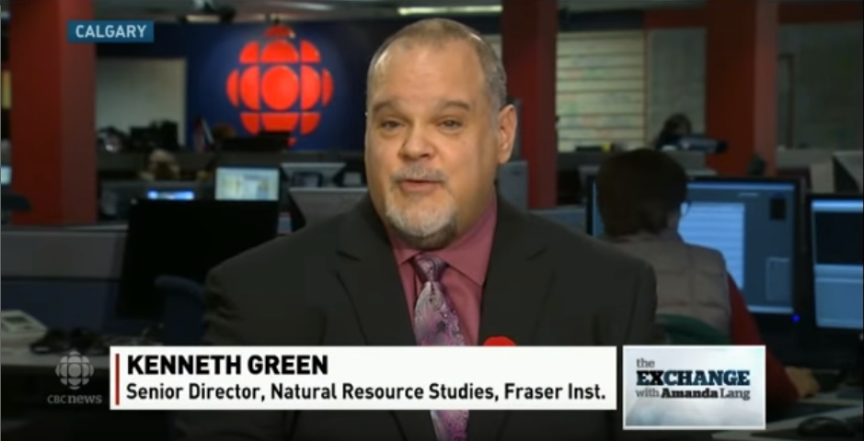
Persuasion via media
Notes:
Links w/ Donor
Agenda
Traditional
Canada
US
Sinclair
Social
Canada
Ontario Proud
PC Fed
Navigator
Harris
Sun News Network
Toronto SUN
Cdn Tax Payers Federation
Ontario News Now

Slide 10
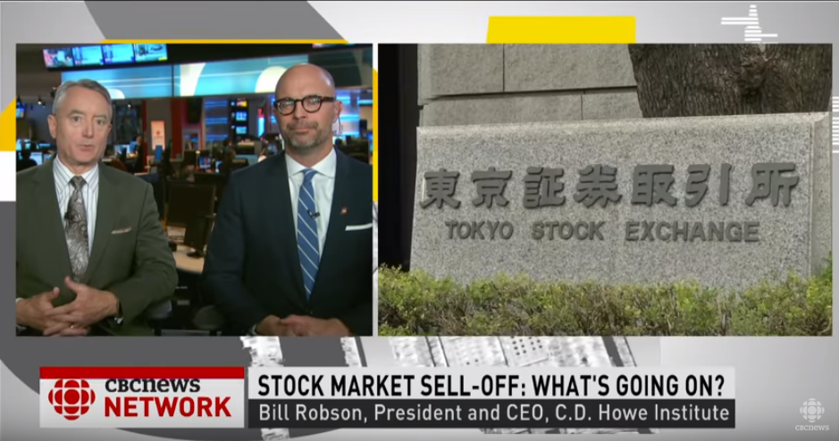

Slide 11
Conclusion
Key Takeaways
30 seconds

Slide 12
References
Key Takeaways
30 seconds
Notes:
https://www.youtube.com/watch?v=p_4cf8jKHWU
https://www.nytimes.com/2016/08/08/us/politics/think-tanks-research-and-corporate-lobbying.html
https://www.nytimes.com/2016/08/08/us/politics/think-tanks-research-and-corporate-lobbying.html

